Slide 1
Pathfinding
In Clojure
All images licensed under CC0 Creative Commons unless otherwise noted

Slide 2
What is pathfinding?
Find the shortest¹ path between two points
More generally known as the shortest path problem
Typically applied to graphs
Can be applied to abstract problems
eg, finding a “path” through a graph of states to reach a desired state
1. Shortest or “cheapest”, for example, preferring large roads over small

Slide 3
Algorithms
Breadth-first Search
Dijkstra’s Shortest Path
A*
Very similar algorithms, build on each other

Slide 4
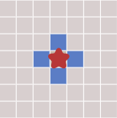
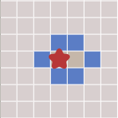
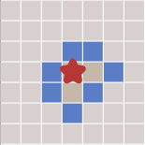
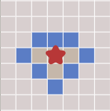
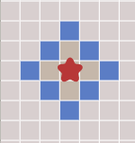
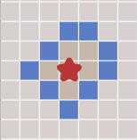
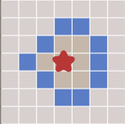
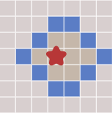
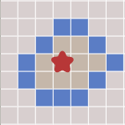
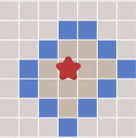
Breadth-first Search
Explores each neighbouring “node” before exploring deeper
Grid images Copyright Red Blob Games, taken from https://redblobgames.com

Slide 5
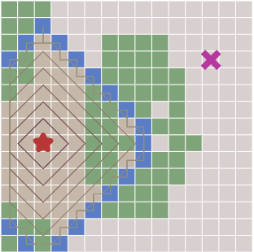
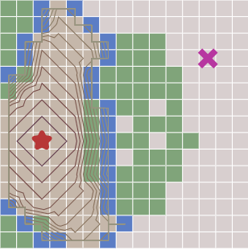
Dijkstra’s Shortest Path
Similar to BFS, but explores “cheapest” neighbours first
Breadth First
Dijkstra’s algorithm
Grid images Copyright Red Blob Games, taken from https://redblobgames.com

Slide 6
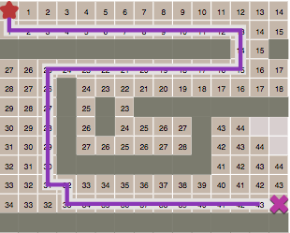
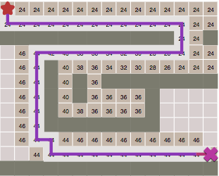
A* Search
Like Dijkstra’s but prefers neighbours that get closer to goal
Dijkstra’s algorithm
A* Search
Grid images Copyright Red Blob Games, taken from https://redblobgames.com

Slide 7
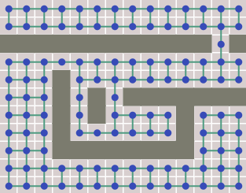
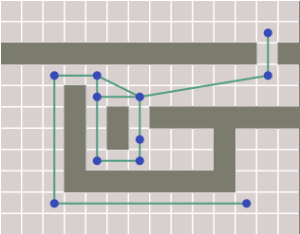
Map Representation
Map is a graph of connected nodes (the neighbours)
Grid is converted into graph structure prior to running search
Waypoints would be more efficient…
Grid images Copyright Red Blob Games, taken from https://redblobgames.com

Slide 8
Implementation
Keep a queue of “frontier” nodes (unexplored neighbours)
For each frontier node in turn, explore
Explore = if goal then done else add all neighbours to frontier
Keep a “came-from” map of current-node → previous-node
“came-from” map used to reconstruct path at the end
This is essentially BFS! Dijkstra & A* simply modify the order in which the frontier nodes are explored

Slide 9
Challenges in Clojure
Clojure likes things to be immutable
Frontier queue is modified as its being consumed
Cannot simply map/reduce over a frontier node sequence

Slide 10
Solutions
Use loop/recur
Manually loop through frontier, allowing us to add extra nodes when we recur, if needed
Use iterate
Allows us to generate a new state (frontier queue etc) given the previous state
f(previous) = successor

Slide 11
Loop/recur
(loop [frontier [start]
came-from {start :start}]
(let [current (first frontier)]
(if (not= current goal)
(let [neighbours (get-neighbours current)]
(recur (concat (next frontier) neighbours)
(into came-from
(for [neighbour neighbours]
[neighbour current]))))
came-from)))

Slide 12
get-neighbours
Gets the current node from the global graph
Gets all neighbour node keys
Removes neighbours already contained in comes-from map

Slide 13
iterate
(take 5 (iterate (fn [x] (* x 2)) 1))
=> 1
((fn [x] (* x 2)) 1)) => 2
((fn [x] (* x 2)) 2)) => 4
((fn [x] (* x 2)) 4)) => 8
((fn [x] (* x 2)) 8)) => 16
=
(1 2 4 8 16)

Slide 14
iterate
(->> {:frontier [start]
:came-from {start :start}}
(iterate
(fn [{:keys [frontier came-from]}]
(let [current (first frontier)]
(when (not= current goal)
(let [neighbours (get-neighbours current)]
{:frontier (concat (next frontier)
neighbours)
:came-from (into came-from
(for [neighbour neighbours]
[neighbour current]))})))))
(take-while identity)
last
:came-from)

Slide 15
Dijkstra’s Algorithm
Takes “cost” of a neighbour into account and explores lowest cost first
(loop [frontier (priority-queue start)
came-from {start :start}
cost-so-far {start 0}]
(let [current (first (peek frontier))]
(if (not= current goal)
(let [neighbours (get-neighbours current)
costs (get-costs current neighbours
cost-so-far)]
(recur (into (pop frontier)
(for [[node-id cost] costs]
[node-id cost]))
…
(into cost-so-far costs)

Slide 16
get-costs
(defn get-costs
[current neighbours cost-so-far]
(->>
(for [neighbour neighbours]
(let [new-cost (+ (get cost-so-far current)
(get-cost current neighbour))]
(when (or (not (contains? cost-so-far
neighbour))
(< new-cost (get cost-so-far
neighbour)))
[neighbour new-cost])))))

Slide 17
A* Search
One-line change to Dijkstra’s algorithm! (…plus a heuristic fn)
…
(recur
(into (pop frontier)
(for [[node-id cost] costs]
[node-id (+ cost (heuristic goal node-id))]))
…
(defn heuristic
“Manhattan distance on a square grid”
[goal current]
(let [[ax ay] goal
[bx by] current]
(+ (Math/abs (- ax bx))
(Math/abs (- ay by)))))

Slide 18
Why does it work?
Dijkstra calculates the total cost from start to neighbours
Frontier queue is a priority queue
Calculated cost used as priority in frontier queue
Lowest cost items are taken from priority queue first
A* adds the heuristic (in this case, manhattan distance) to the cost, forcing the queue to prefer “closer” neighbours

Slide 19
Resources
Amit Patel/Red Blob Games
https://www.redblobgames.com/pathfinding/a-star/introduction.html
Sample code for this talk (uses “iterate” not “loop/recur”)
https://github.com/danielytics/pathfinding-talk

Slide 20
Questions?

